Slide 1
CARDIAC MURMURS
DR NIYAS K NASEER
DM RESIDENT

Slide 2
subtitles
DEFINITION
MECHANISM OF PRODUCTION
CHARACTERISTICS OF MURMUR
DYNAMIC AUSCULTATION
SYSTOLIC MURMURS
DIASTOLIC MURMURS
CONTINUOUS MUMRURS

Slide 3
DEFINITION
A cardiac murmur is defined as a relatively prolonged series of auditory vibrations of Varying intensity(loudness), frequency (pitch), quality, configuration, and duration

Slide 4
MECHANISM OF MURMUR PRODUCTION
TURBULENT BLOOD FLOW

Slide 7
CHARACTERISTICS OF MURMUR
TIMING
LOCATION
DURATION
INTENSITY
FREQUENCY
CONFIGURATION
TRANSMISSION
DYNAMIC AUSCULTATION

Slide 8
1. TIMING OF MURMUR
SYSTOLIC MURMUR
DIASTOLIC MURMUR
SUBCLASSIFICATION-EARLY , MID , LATE OR PAN(HOLO)
CONTINUOUS MURMUR

Slide 10
2. LOCATION OF MURMURS

Slide 12
3. DURATION OR LENGTH
SHORT ,LONG OR HOLO
Depends on duration of events such as pressure gradient between the two sites or cardiac chambers
reflects the severity of lesion in stenotic lesions

Slide 13
4. INTENSITY OR LOUDNESS

Slide 14
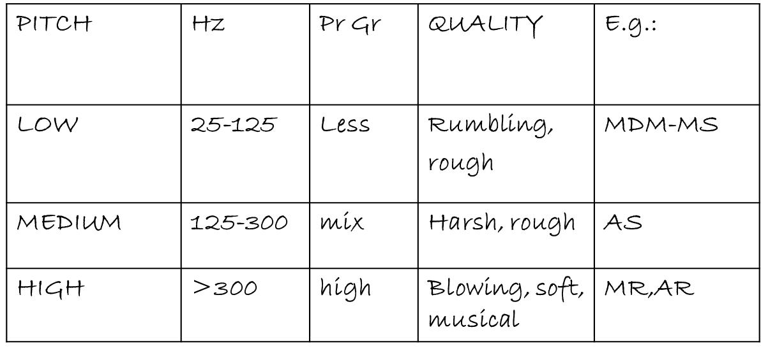
5. PITCH OF THE MURMUR
pressure gradient between 2 chambers – flow velocity

Slide 16
6.CONFIGURATION OR SHAPE OF MURMUR

Slide 17
7. TRANSMISSION OF MURMUR
Conduction with direct anatomical continuity | SM of AS to carotids PSM of MR to left axilla
Loud vs soft | Loud-transmit widely Soft-confined
High freq transmit proximally while low freq transmit distally | MR to apex AS to base and carotid
Low vs high freq murmurs | Low freq-better transmitted to surface –thrill High freq –poorly transmitted – no thrill

Slide 18
DYNAMIC AUSCULTATION

Slide 19
DEFINITION
technique of altering circulatory dynamics by a variety of physiological manoeuvres and determining the effects of these manoeuvres on heart sounds and murmurs

Slide 20
INTERVENTION
RESPIRATION
POSITION
PHYSICAL MANEUVERS
PHARMACOLOGICAL

Slide 21
RESPIRATION - INSPIRATION
↓ INTRATHORACIC PRESSURE
↑ VENOUS RETURN to right side of the heart AND Dilatation of pulmonary vascular system causing decrease in pulmonary impedance there by increasing pulmonary hang out interval(>80 ms)
↑ stroke volume of right side
accentuation of R side murmur

Slide 22
EXPIRATION
↓ lung volume → ↑ pulmonary venous flow
left sided murmurs are loudest during expiration
except
MR which remain unchanged

Slide 23
Murmurs accentuated during
Inspiration
TS
TR (Carvallo’s sign)
PR
Mild or moderate PS
Severe PS no further increase in gradient
Expiration
• MS
• AS
• AR
• VSD
• Pericardial rub (AP diameter)

Slide 24
In RV failure and PHT
high Rt heart filling pressures ,no increase in venous return with inspiration, hence no inspiratory augmentation of right sided murmurs and gallops
Absence of respiratory influence is of no particular diagnostic value.
Effects of inspiration may be accentuated by Muller maneuver.

Slide 25
postural
Auscultation is carried out immediately before and after the change in posture since effects may be quite transient persisting for only 10 – 15 heart beats

Slide 26
STANDING
Rapid standing or sitting up from lying position or rapid standing from squatting posture results in
decreased venous return due to venous pooling in legs and splanchnic vessels leads to-
decreased stroke volume
decreased mean arterial pressure
decrease in heart size
followed by reflex increase in heart rate & systemic resistance

Slide 27
STANDING
All murmurs decrease except-
ESM of HOCM becomes louder and longer
Click occurs earlier, murmur becomes longer in MVP while loudness shows variable response

Slide 28
SQUATTING
Sudden change from standing to squatting leads to-
Increases venous return & Stroke Volume
Increase of systemic vascular resistance due to kinking of iliac artery and reduction of pressure of gravity
Increase of systemic Arterial pressure with transient bradycardia
Notes:
Squatting from a standing position is associated with a simultaneous increase in venous return (preload) and systemic vascular resistance (afterload) and a rise in arterial pressure

Slide 29
SQUATTING
Increased venous return and CO - augments most murmurs (AS,PS,MR,AR,VSD) Right heart murmurs do so earlier
Increased left ventricular volume - decreases murmur of HOCM and delayed murmur and click of MVP
Ejection murmur of TOF↑ due to increase pulmonary blood flow and decrease in right to left shunt

Slide 30
OTHER POSTURAL CHANGES
Left Lateral Position
Causes closeness of heart to chest wall and transient rise of HR. So leads to –
Increased murmur of MS, MR and austin flint murmur of AR
Early appearance of click and systolic murmur of MVP due to increase HR.(increase HR & inotropism)

Slide 31
Sitting up and leaning forward
causes more closeness of base of heart to chest wall so AR and PR murmurs more readly audible
PRONE POSITION & KNEE CHEST POSITION
Bring heart close to chest wall making pericardial rub more prominent

Slide 32
VALSALVA MANEUVER
Described in 1704 –Antonio Maria Valsalva
Relatively deep inspiration followed by forced exhalation against a closed glottis for 10 to 20 seconds
Manometer method:
Patient blows into the mercury manometer and maintains 40 mmHg for 15 seconds

Slide 33
VALSALVA EQUALENTS
Patient pushes back against examiner’s hand which is pressed downward on mid abdomen.
Caution : Not to be performed in IHD as it will reduce Coronary Blood Flow.
It consists of 4 phases
Clinically phase 1 and 3 are not perceptible at bedside

Slide 34
PHASES OF VALSALVA
PHASE 1-due to increase in intra thoracic pressure there is transient rise in LV output and systemic arterial pressure but there occurs fall in HR
PHASE 2(stain phase)- decrease in venous return first to right then to left leads to decrease in systolic, diastolic and pulse pressure and reflex tachycardia

Slide 35
PHASES OF VALSALVA
PHASE 3- cessation of staining result in-
sudden increase in systemic venous return
but transient decrease in arterial pressure due to fall in intra-thoracic pressure
PHASE 4- return to pre valsalva
a transient overshoot of systemic arterial pressure
Reflex bradycardia

Slide 37
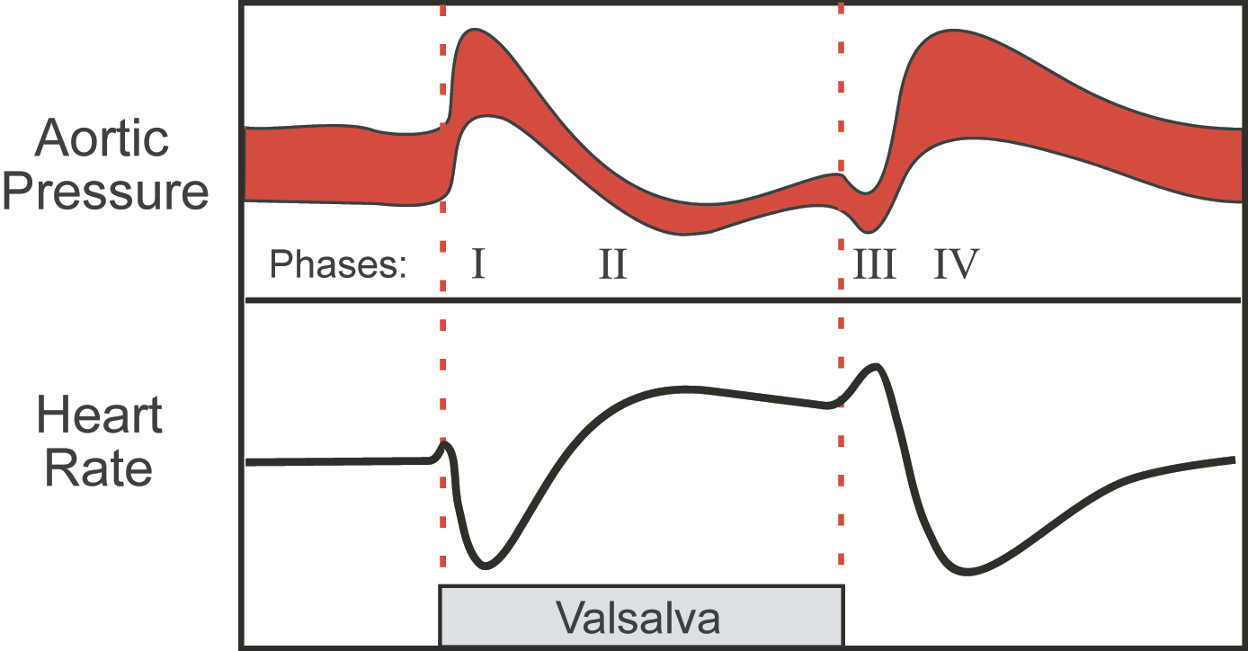
PHASE | BP | HR
1 | INCREASE | DECREASE
2 | DECREASE | INCRESAE
3 | DECREASE | INCREASE
4 | INCREASE | DECREASE

Slide 38
EFFECTS ON MURMUR
PHASE 2–as stroke volume fall - there is decrease in –
systolic murmur of AS, PS, MR, TR
diastolic murmur of AR PR MS TS
PHASE2- reduction in LV volume and size leads to-
increase in systolic murmur of HOCM(increase LVOTO)
increase in degree of MVP prolapse(louder and early midsystolic click and SM in MVP(increase in degree of prolapse)

Slide 39
PHASE 3- sudden increase in Systemic venous Return leads to increase in right side murmurs
PHASE 4-left side murmur comes to control levels and may transiently increase

Slide 40
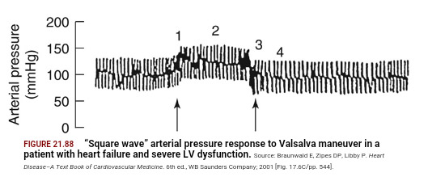
HEART FAILURE
Phase 1 and 3 are normal but there is absence of decrease in arterial pressure tracing during phase 2 and overshoot of BP does not occur in phase 4-since baroreceptors are not activated
SQUARE WAVE RESPONSE

Slide 41
MULLERS MANEUVER
Converse of Valsalva Maneuver
Less frequently employed
Forcibly inspires while the nose is held closed and mouth is firmly sealed for about 10 sec
Augments murmur and filling sound originating in right side of the heart

Slide 42
ISOMETRIC EXERCISE
Handgrip with both hands simultaneously for 20-30sec
Use calibrated handgrip device or tennis ball or rolled up BP cuff.
Measure the maximum effort
Patient exerts 70 – 100% of this maximum for about 30 seconds
CAUTION:
Valsalva maneuver during handgrip should be avoided
Avoid in those with ventricular arrhythmias and myocardial ischemia
Contraindicated in recent myocardial infarction, uncontrolled hypertension, cerebrovascular disease, suspected aortic dissection

Slide 43
ISOMETRIC EXERCISE
Hemodynamic changes:
Significant increase in SVR
Arterial pressure
Heart rate
LV filling pressure
LV size

Slide 44
ISOMETRIC EXERCISE
Systolic Murmur of AS reduced due to reduced gradient across aortic valve
AR , MR , VSD – increased due to increase systemic vascular resistance
MDM of MS – increased due to Increased CO
Syst Murmur of HOCM reduced
MVP murmur + click delayed

Slide 45
CARDIAC CYCLE LENGTH CHANGES POST PVC AND AF
CP-↑ preload will increases ventricular filling and size
Also in addition there is secondary increase in ventricular contractility of new beat and transient increase in arterial pressure.

Slide 46
CARDIAC CYCLE LENGTH CHANGES

Slide 47
Increased ( L or R vent ejection murmurs )
AS
PS
HOCM(there is increase in SM due to increase LVOTO- known as BROKENBROUGH BRAUNWALD SIGN)
MS click and late SM of MVP are delayed
No change for MR , TR or VSD
DM of AR increases due to transient rise in arterial pressure

Slide 48
AMYLNITRITE INHALATION
Inhalation of Amyl Nitrate
Crush ampoule in towel and take 3-4 deep breaths over 10 – 15 secs
Changes observed-
< 30 secs : Systemic vasodilatation->decrease SVR
30 – 60 secs : increase HR & CO
However majority of auscultatory changes are observed in first 30 sec

Slide 49
Due to increase in CO-increase
SM of AS and PS
SM of TR
All functional SM
DM of MS and TS
DM of PR

Slide 50
Due to decrease in SVR following murmur are decreased-
SM of MR
DM and austin flint murmur of AR
SM of TOF
Due to decrease LV volume and size –
SM of HCM increases
early appearance of MVP click and murmur but softening of murmur occur due to decrease resistance to LV resistance

Slide 51
METHOXAMINE & PHENYLEPHRINE
Opposite effect of Amyl Nitrate
Phenylephrine - due to short duration of action
Systolic pressure elevated by 30 mm Hg for 3 to 5 mts
EFFECT
Increases systemic arterial pressure
Reflex Bradycardia , decrease CO, decrease Contractility
Caution : Not to be used in patients with CHF or Systemic hypertension.

Slide 52
METHOXAMINE & PHENYLEPHRINE
↑ BP & SVR ↓ CO & HR – last for 3-5mts
AR , MR , VSD , TOF – Louder
SM OF AS, PS and DM of PR and TS -show no changes
LV size increases HOCM – Softer
Click and Murmur of MVP - Delayed

Slide 54
SYSTOLIC MURMUR

Slide 56
EARLY SYSTOLIC MURMURS
Early systolic murmurs begin with S₁ and extend for a variable period of time, ending well before S₂ (high pitch ,decrescendo)
1. Acute severe mitral regurgitation
Regurgitation occurs into a normal-sized, relatively noncompliant left atrium and as LV-LA pressure gradient is abolished during late systole, termination of retrograde flow occurs well before S2.
best heard at apical impulse
Caused by:
i. Papillary muscle rupture due to ischemia
ii. Infective endocarditis -destruction of leaflet tissue, chordal rupture, or both

Slide 57
iii. Rupture of the chordae tendineae in myxomatous mitral valve disease
iv. Blunt chest wall trauma-papillary muscle contusion and rupture, chordal detachment, or leaflet avulsion.
2.Congenital, small ventricular septal defect-
ventricular size decrease and septum thickness increases which seals off defect

Slide 58
3. VSD with high PA pressure-
high pulmonary resistance will decrease the late shunting

Slide 59
MIDSYSTOLIC (EJECTION) MURMURS
Begin at a short interval following S₁, end before S₂
Flow across LV or RV outflow tract- when flow proceeds , murmur increase in crescendo and when it decrease murmur decrease in decrescendo.
Intensity of murmur depend on cardiac output

Slide 60
Causes are:
1. Innocent: due to flow across normal ventricular outflow tract
2. Functional: dilation of aortic root, pulmonary trunk or increase flow into aorta and pulmonary artery
3. Pathologic
are secondary to structural CV abnormalities-ventricular outflow obstruction
e.g. Aortic stenosis, Hypertrophic cardiomyopathy, Pulmonic stenosis

Slide 61
Aortic stenosis
Harsh, medium pitch, loudest in aortic area; radiates along the carotid arteries and apex.
Intensity varies directly with CO
Severity varies with murmur may have an early peaking and short duration or late peaking and prolonged duration.
A/W parvus et tardus
Other conditions which may mimic the murmur of aortic stenosis w/o obstructing flow:
1. Aortic sclerosis
2. Bicuspid aortic valve
3. Dilated aorta
4. Increased flow across the valve during systole

Slide 62
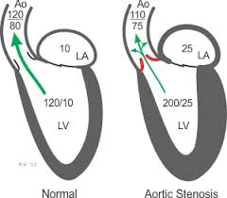
2
Notes:
IVC SI VENTRICULAR PRESSURE INCREASES – OPENING OF AORTA & PULM VALVE-EJECTION –MURMUR BEGINS—CRESENTO DECRESENTO-.. MURMUR ENDS BEFORE VENTRICULAR PRESSURE DROPS BELOW AORTIC PRESSURE AT WHICH AORTIC VALVEAND PULMONARY VALVE CLOSES GENERATING A2 & P2

Slide 63
GALLAVERDIN PHENOMENON/HOURGLASS PHENOMENON
Noisy medium pitch murmur at base due to turbulence of high velocity jet and
High frequency murmur reflected to mitral area (apex) due to periodic wake phenomenon caused by high frequency vibrations of the fibrocalcific aortic cusps – mimic MR (S2 clear, increase mr in PVC/AF)

Slide 64
 | AS | MR
Location | Aortic area | Apex
Radiation | Neck | Axilla
Shape | Diamond | Holosystolic
Pitch | Medium | High
Associated signs | Decreased A2 Slow rising and delayed pulse Ejection click S4 Narrow pulse pressure | Decreased S1 Laterally displaced diffuse PMI S3
POST PVC | INCREASES | NO CHANGE
Isometric Exercise | DECREASES | INCREASES
Amyl Nitrate | INCREASES | DECREASES

Slide 65
AORTIC STENOSIS -TYPES

Slide 66
HYPERTROPHIC CARDIOMYOPATHY
Loudest b/t left sternal edge and apex; Grade 2-3/6
Does NOT radiate into neck; carotid upstrokes are brisk and may be bifid
Factors which increase intensity:
Increase LV contractility :exercise ,catecholamine ,digitalis
Decrease ventricular volume:valsalva,standing,amyl nitrates,tachycardia
Decrease aortic impedance and pressure:sustained handgrip,passive leg raising

Slide 68
MANEUVERS | FIXED LVOT-AS | DYNAMIC LVOT-HOCM
RESPIRATION | NOT MUCH CHANGE | MAY INC WITH EXPIRATION
STANDING | DECREASES | INCREASES
SQUATTING | INCREASES | DECREASES
VALSALVA | DECREASES | INCREASES
BROCKENBROUGH | NORMAL | POSITIVE

Slide 69
PULMONARY STENOSIS
Murmur brought on by a phasic ejection click: radiates up and left
As severity increases length increases and P2 becomes soft (abruptness of closure reduced ) ,S2 split widens S4.becomes kite like
May engulf A2 and P2 :may confuse with VSD

Slide 70
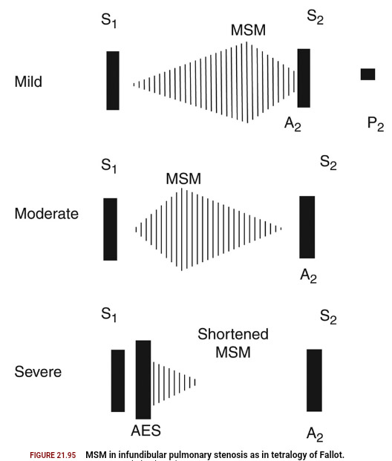

Slide 71
OTHER CAUSES OF MSM
Dilation of aorta and pulmonary trunk
Short soft midsystolic murmur
Left sided murmur in marfans syndrome , syphilis
Right sided murmurs in idiopathic dilation of pulmonary artery,pulmonary hypertension
MSM of hyperdynamic circulation
Normal aorta or pulmonary trunk but increased flow
Anaemia , pregnancy , fever , thyrotoxicosis

Slide 72
OTHER CAUSES OF MSM
OS-ASD
Rapid flow across pulmonary valve to dilated pulmonary trunk
Pure AR
Due to accelerated LV ejection

Slide 73
PHYSIOLOGICAL CAUSES
INNOCENT SYSTOLIC MURMUR
Stills murmur
Pulmonary mid systolic murmur
Peripheral pulmonary systolic murmur
Supraclavicular or brachiocephalic systolic murmur
Aortic sclerosis
Systolic mammary soufflé

Slide 74
STILLS MURMUR
Short buzzing murmur twanging of rubber band
Pure medium frequency by periodic vibrations of pulmonic leaflets at their attachment

Slide 75
Pulmonary mid systolic murmur and peripheral pulmonary mid systolic murmur
Angulation and disparity between pulmonary trunk and its branches turbulent flow
Normally disappears with maturity of pulmonary bed

Slide 76
Supraclavicular or brachiocephalic systolic murmur
Aortic origins of major normal brachiocephalic arteries
Crescendo decrescendo , abrupt onset ,short,sometimes radiating below clavicle
Vs supraclavicular AS –these murmurs are softer below clavicle and decrease with shoulder abduction

Slide 77
MAMMARY SOUFFLE
Late pregnancy or pueperium
Sometimes continuous louder in systole , distinct gap from S1(time for ejection blood to reach mammary arteries)
2 or 3 RICS/LICS
Light pressure augments murmur becomes continuous firm pressure abolishes murmur

Slide 78
Pansystolic (Holosystolic) Murmurs
Are pathologic
Murmur begins immediately with S1 and continues up to S2
1. Mitral valve regurgitation
Loudest at the left ventricular apex
Radiation reflects the direction of the regurgitant jet
i. To the base of the heart = anterosuperior jet (flail posterior leaflet)
ii. To the axilla and back = posterior jet (flail anterior leaflet
Also usually associated with a systolic thrill, a soft S3, and a short diastolic rumbling (best heard in left lateral decubitus
2. Tricuspid valve regurgitation
3. Ventricular septal defect

Slide 79
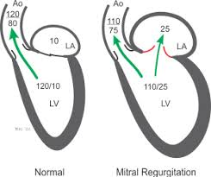
MITRAL REGURGITATION

Slide 80
TRICUSPID REGURGITATION
LLSB-RA
RIVERO CARVALLO SIGN – increased RV ,increase RV volume increased SV velocity of regurgitant flow
Sometimes TR heard only during inspiration
Carvallo sign disappears in RV failure

Slide 81
VENTRICULAR SEPTAL DEFECT
Depends on site ,size and gradient
Very restrictive VSD –ESM decrescendo pattern
Mod and NR VSD –PSM
Sub arterial VSD -1 or 2 LICS similar to PS murmur
Septal aneurysm – click with LSM OR PSM with late systolic accentuation
Large shunt – MDM
NR VSD with PAH – ESM
PSM absent in Eissenmenger syndrome –only pulmonary ESM

Slide 82
Other PSM
Aorto Pulmonary window with PAH
Otherwise continuous murmur
Diastolic component reduced due to increased PAH
PDA with PAH

Slide 83
LATE SYSTOLIC MURMUR- MVP
Leaflet remains competent during early ventricular contraction but overshoot in late systole ( critical V dimensions )
One or more mid systolic clicks precede murmur (sudden deceleration of the column of blood against the prolapsed leaflet or scallops)
Longer and softer
prompt standing after squatting
valsalva II
Short and louder
squatting
sustained hand grip
amyl nitrate
Other LSM- papillary muscle dysfunction
Post papillary muscle – Late systolic crescendo to S2

Slide 84
 | MVP | HCM
CLICK | PRESENT | ABSENT
POST ECTOPIC BEAT | DO NOT CHANGES | DECREASES
AMYL NITRATE | BI PHASIC | INCREASES

Slide 85
DIASTOLIC MURMUR

Slide 87
EARLY DIASTOLIC MURMUR
AORTIC REGURGITATION:
Soft high frequency EDM with pt sitting & leaning forward , breath held in full expiration
3 LICS [2 or 3 RICS in root dilatation
Musical quality in eversion
Austin flint murmur
Cole Cecil murmur-AR murmur in left axilla due to high position of apex

Slide 89
AR
Difference between acute and chronic AR
A/C AR | C/C AR
Short mur. -early equalization of diastolic pressures | Long mur.
Medium n –velocity less rapid and pressure gradient lower | High n
Associated S₄

Slide 90
High Pressure PR
High pitched soft blowing decrescendo murmur usually lasts throughout diastole heard in the left upper sternal border
Associated with loud P2 and other features of PAH
PR vs. AR
Loud P2, murmur begins after P2
Normal pulse pressure
Clinical setting
Squatting and sustained hand grip increases AR

Slide 91
High Pressure vs. Normal Pressure
High Pressure | Normal pressure
Decrescendo | Crescendo decrescendo
High frequency | Medium to low pitched
Onset immediately with p₂ | Delayed in onset
Usu extends throughout diastole | Short duration
Features of PAH present | Usually absent

Slide 92
MID DIASTOLIC MURMUR
Begins at clear interval after A2
1.Rapid filling phase:
AV valve obstruction- stenosis AV valves, tumors, functional obstruction
abnormal pattern of AV flow : increased flow volume , increased flow velocity
2. Incompetent pulmonary valve [PR in normal PA pressure]
3. Atherosclerotic extramural coronary arteries

Slide 93
MID DIASTOLIC MURMUR
RV
- TS
LV
- MS
Austin Flint murmur
- Carey-Comb's
OTHERS
-Atrial Myxoma
ASD
- VSD
- PDA
- MR

Slide 94
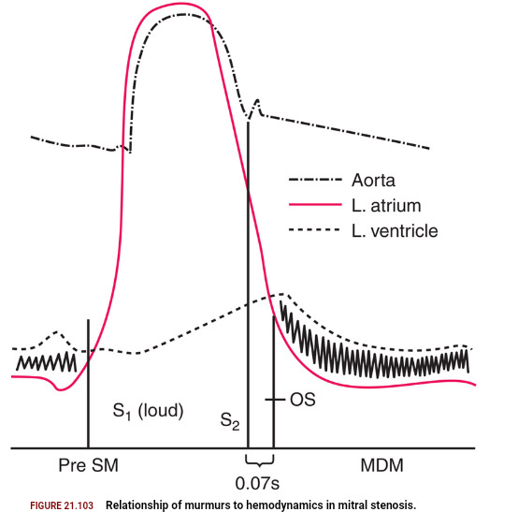
MITRAL STENOSIS
Low pitch rough rumbling [sound of distant thunder] MDM
Localized to apex, better heard in left lateral position with bell
Length - severity
Long murmurs up to S1 even in long cycles of AF- severe MS
Late diastolic or Pre systolic accentuation usually seen in pliable valves and in NSR [ sometimes in AF]
Notes:
OS- leaflet excursion comes to its anatomical limits because of its commissural tethering, part of the column of blood will be decelerated suddenly, along with the doming anterior leaflet.

Slide 96
TRICUSPID STENOSIS
Similar to MS
Murmur usually seen associated with AF
Diff. from MS
Increases during inspiration [Augmentation of RV volume]
LLSB

Slide 97
AUSTIN FLINT MURMUR
Severe AR regurgitant jet directed toward the AML prevent the latter from opening well during diastole generating turbulent flow
Low pitch MDM or late diastolic, best heard at the apex.
To differentiate from MS
No OS
Amyl nitrate inhalation

Slide 99
Late Diastolic/ Pre-systolic Murmurs
MS
Higher frequency than MDM
Sometimes only PSA heard- mild MS
Generally absent in calcified valves and most of AF [ may be present during short cycle lengths in AF]
Cause-
Increased flow during atrial contraction in late systole

Slide 100
Other Mid Diastolic Murmur
Carey Coomb’s murmurs
Acute rheumatic fever- mitral valve structures acutely inflamed with some thickening and edema
CAUSES- turbulence of flow during the rapid filling phase.
+ moderate MR [increased mitral inflow in diastole]
Low pitched short MDM.
good evidence of active carditis

Slide 101
Other diastolic murmurs
Cabot– Locke Murmur- [Diastolic Flow murmur]
The Cabot–Locke murmur is a diastolic murmur that sounds similar to aortic insufficiency but does not have a decrescendo; it is heard best at the left sternal border. [High flow thru coronary vessels, LMCA, LAD]
The murmur resolves with treatment of anaemia.
Dock’s murmur
diastolic crescendo-decrescendo, with late accentuation, [consistent with blood flow through the coronary] in a sharply localized area, 4 cm left of the sternum in the 3LICS, detectable only when the patient was sitting upright.
Due to stenosis of LAD

Slide 102
Other diastolic murmurs
Key–Hodgkin murmur
EDM of AR; it has a raspy quality, [sound of a saw cutting through wood]. Hodgkin correlated the murmur with retroversion of the aortic valve leaflets in syphilitic disease.
Rytand’s murmur in complete heart block
MDM or Late diastolic murmur
Atrial contraction coincides with the phase of rapid diastolic filling increased flow short MDM [intermittent].
Another theory- Delayed V. contraction following A. contraction may lead to diastolic MR & TR, because AV valve closure does not occur [unless V. systole supervenes]. When higher V than A pressure during atrial relaxation, an incompletely closed AV valve may lead to a reverse gradient with a considerable regurgitation volume.

Slide 103
CONTINUOUS MURMUR

Slide 104
CONTINUOUS MURMUR
Begin in systolic and continue without interruption through the timing of S2 into all or part of diastole without change in character
D/D: to and fro murmurs of VSD + AR ,AS + AR ,MS + MR

Slide 106
1.Connection b/w high pressure/vessel & low pressure chamber/vessels
1.From the aorta
a.persistent ductus arteriosus
b.Aorto-pulmonary window
c.RSOV
2.From the coronary artery
a.coronary arteriovenous fistulae draining into RA,RV,PA
b.ALCAPA
3.Other AV communications
a.Bronchopulmonary collaterals
b.chest wall arteries-pulmonary vessels
3.Peripheral A-V Fistula
4.Others
a. lutenbachers syndrome with restricted ASD

Slide 107
PDA
Gibsons murmur
At 1 or 2 LICS
NR- high frequency soft murmur peaks around S2
Mod R- loud coarse machinery murmur with eddy sounds

Slide 108
PDA with no continuous murmur
Neonates- due to high PVR
Very small ductus
Very large ductus &large VSD –due to equalization of pulmonary and systemic pressure
PAH –first diastolic component goes, then systolic
AS,CoA-due to low aortic pressure

Slide 109
CONTINUOUS MURMURS
APW
2 or 3 LICS
Usually associated with early development of eisenmenger
RSOV
No peaking at S2 seen [ peaks in systolic and diastolic ]
To RA- RLSB
To RV-LLSB
RVOT-3LICS
Lutenbachers syndrome with restricted ASD
LLSB (body of RA)

Slide 110
CONTINUOUS MURMURS
C-AVF
RA-RLSB or RUSB
LA-ULSB rad to Lt ant ax line
CS- back B/w spine & Lt scapula
Lt SVC –upper to mid LSB
RV inflow –LLSB
RVOT –upper to mid LSB
PA – ULSB

Slide 111
ALCAPA
Murmur louder in diastole [LV contraction D/C flow]
Do not peak at S2
Usually LUSB or RUSB

Slide 112
Due to rapid blood flow
AV fistula
Murmur heard in the venous side
Due to rapid blood flow
cervical venous hum,mammary souffle, hyperthyroidism,hemangioma,hyperemia of neoplasm(HCC,RCC,Pagets disease)
Stenosed arteries with inadequate distal collaterals
Aortic arch vessels occlusion ,atherosclerotic carotids ,coarctation of aorta,main pulmonary artery stenosis and peripheral pulmonary artery stenosis

Slide 113
Disturbances in flow patterns in veins
VENOUS HUM
Healthy children ,young healthy adults ,pregnancy
Sitting ,bell,medialaspect of Rt S.Cl fossa ,with face pulled leftwards and upwards disappears when returned to normal position .
Louder in diastole , +/- high pitched whine
Radiation to infraclavicular areas confuse with other murmur.Check by obliteration

Slide 114
appreciating murmurs important ?

Slide 115
All MURMURS TO BE EVALUATED ?

Slide 116
References
1. Braunwald 10th edition , textbook of cardiovascular medicine
2. Synopsis of cardiac physical diagnosis, Abrams,Jonathan
3. Clinical examination in cardiology ,2nd edition:B.N.Vijay Raghawa Rao

Slide 117
MCQ
Effect on SM are similar in HOCM and MVP in all this manuevers EXCEPT
Amyl nitrate inhalation
Valsalva
Handgrip
Post PVC

Slide 118
2. Murmur increases on hand grip in ……………….
A. AS
B. PS
C. AR
D. HOCM
E. VSD

Slide 119
3. Brokenbrough Brauwnwalds sign indicates
Decrease SM in HOCM on handgrip
Decrease SM in HOCM on amyl nitrate inhalation
Increase SM in HOCM in PVC
Increase SM in HOCm on handgrip

Slide 120
4. Complete heart block is associated with:
A. ESM
B. MSM
C. MDM
D. EDM

Slide 121
THANK YOU

